Slide 1
Topological Analysis of Seizure-Induced Changes in Brain Hierarchy Through Effective Connectivity
Authors: Anass B. El-Yaagoubi, Moo K. Chung, Hernando Ombao
Presented By: Dhruva Sharma, Sneha Kandpal, Aman Raj

Slide 2
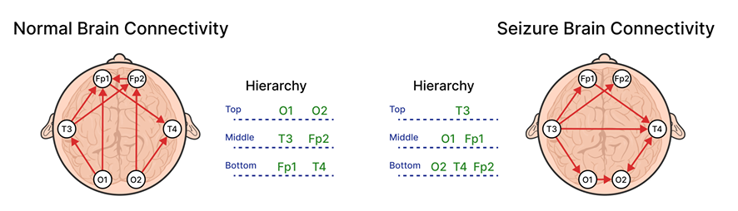
Introduction
Topological Data Analysis (TDA), particularly Persistent Homology, extracts stable multiscale structure from complex data and has been used to compare brain-network organization across states.
Need for direction-aware analysis: Many brain processes—especially seizures—are driven by directional information flow across regions, forming transient driver–responder hierarchies that PH alone cannot quantify.
Clinical motivation: During seizures, certain regions briefly act as dominant drivers. Capturing these hierarchical shifts can aid seizure localization and improve interpretability of EEG dynamics.
Goal of this work: Develop a framework that integrates causal inference with topological tools to characterize seizure-induced changes in brain hierarchy.

Slide 3
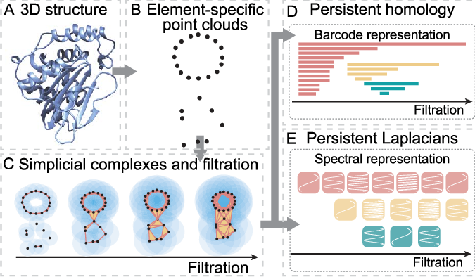
Literature Review
Persistent Homology has been applied in neuroscience to reveal complex brain network patterns but typically assumes symmetric, undirected networks (e.g., based on correlations, coherence). As a result, one-way (causal) influences between regions are overlooked.
Time-series causal methods—Granger causality, DCM, and constraint-based approaches—seek to recover directed interactions from observational data. These approaches differ in assumptions (e.g., linearity, biophysical modeling, conditional independence), leading to trade-offs in robustness and scalability.
Experimental causal interventions (e.g., optogenetics) are the gold standard but impractical in humans; thus researchers infer directed connectivity from observational EEG data.
Newer algorithms handle autocorrelation and high dimensionality by conditioning on lags and controlling false discoveries (e.g., PCMCI). This improves the reliability of inferred directed edges in noisy neural recordings.
HodgeRank (gradient-based ranking) has been used to rank items (e.g. movies, sports teams) in other domains.

Slide 4
Proposed Methods and Work
We propose the Causality-Based Topological Ranking (CBTR) method, which integrates time-aware Causal Inference (CI) to estimate effective, lagged brain connectivity with Hodge (Helmholtz) Decomposition (HD) to produce a hierarchical ranking of regions by mutual influence and reveal how seizures alter the directional architecture of the neonatal brain.
Pipeline Steps:
Causal discovery: Applying a PCMCI-style test across lags per epoch to find parent sets and convert conditional p-values into directed edge weights.
Net-flow formation: Form the directed adjacency matrix W; split into symmetric (mutual) and antisymmetric (net flow Wa) parts.
Hodge decomposition: Apply Helmholtz-Hodge decomposition to Wa (compute gradient (node potentials), curl (local cycles), harmonic).
Scoring & inference: Solve the sparse Laplacian/least-squares for scores, produce per-epoch ranking scores and cycle diagnostics, and statistically compare seizure vs interictal epochs.

Slide 5
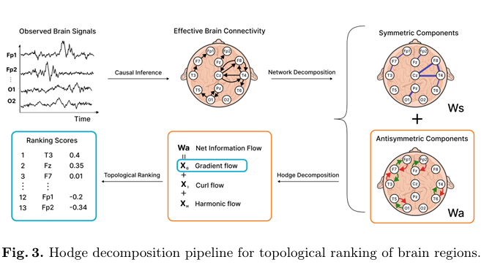
Proposed Methods and Work

Slide 6
Causal Inference (PCMCI)
PCMCI (Peter–Clark Momentary Conditional Independence) is a two-stage causal discovery framework for time series. It combines the PC algorithm with the MCI test:-
Stage 1 (PC Algorithm) identifies potential parents and uses a PC-style conditional-independence search to reduce dimensionality by pruning spurious parents, producing a preliminary time-lagged causal graph.
Stage 2 (MCI Test) evaluates each candidate dependency while controlling for autocorrelation and confounders across multiple lags.
This two-step refinement yields statistically reliable directed edges in complex time-series environments, making it especially effective for revealing directed influence patterns in noisy multivariate signals.
EEG time series have strong autocorrelation, nonlinear interactions, and high dimensionality, conditions where simpler Granger or pairwise causality tests fail. PCMCI’s lag-aware conditional testing avoids inflating false positives and produces a clean, interpretable map of directional influence, which is essential for downstream ranking and Hodge decomposition.

Slide 7


Causal Inference (PCMCI) (Contd)
For each EEG epoch, PCMCI outputs a causal/directed weighted graph representing effective connectivity for that epoch.
MCI p-values across lags are converted into directed connection weights reflecting significant lagged effects across channels.
The directed adjacency matrix W is decomposed into symmetric and anti-symmetric components:
Ws = (W + Wᵀ)/2 (symmetric, mutual two-way bidirectional interactions).
Wa = (W – Wᵀ)/2 (antisymmetric, net directional information flow).
Wa highlights predominant direction of influence, revealing hierarchical structure.
Hodge decomposition requires a reliable estimate of net flow, and PCMCI provides exactly this by producing statistically grounded directed edges. Without PCMCI, the ranking step would reflect correlation—not causation.

Slide 8



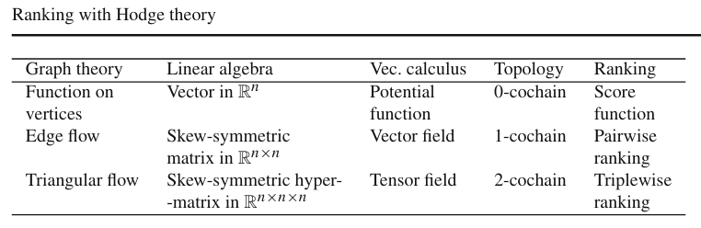
Hodge Decomposition
Hodge (Helmholtz) decomposition splits any anti-symmetric edge flow Wa on a graph into three orthogonal parts: a gradient (global ranking), a curl (local cycles), and a harmonic (global/nonlocal cycles), giving a unique, interpretable decomposition of net flow:
The gradient encodes node potentials and captures transitive, hierarchical influence (who drives whom).
The curl quantifies rotation around triangular faces (3-node cycles) and signals local inconsistencies that prevent a perfect ranking. These operators explain why some networks admit a clean ranking and others do not.
The harmonic component, h captures global cyclic structure not expressible as local curls or gradients (e.g., non-contractible loops in the network topology).

Slide 9
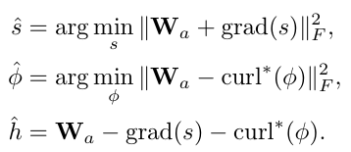
Hodge Decomposition (Contd)
To extract the ranking/gradient , curl, and harmonic parts from the net-flow matrix W_{a}, we solve two core least-squares problems.
  The gradient component is obtained via yielding node potentials, ŝ that best match the observed net flows. The estimated potentials serve as the ranking scores: higher values indicate nodes that exert more net influence on the network.
  We similarly estimate the curl term, φ̂. Its magnitude quantifies local cyclic inconsistencies, revealing where ranking conflicts occur.
  The harmonic residual, ĥ highlights global, non-local cycles. Assessing these across seizure vs interictal epochs provides a detailed picture of how hierarchical structure reorganizes during seizures.
Together, these give a complete decomposition of directional structure.
Helmholtz Hodge Decomposition

Slide 10
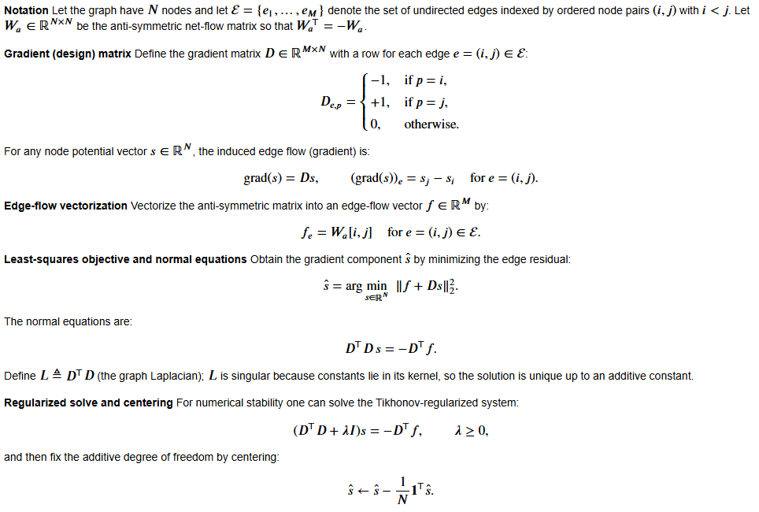
Hodge Decomposition (Algorithm)

Slide 11

Experiment
Simulation scenarios: We tested six distinct simulation scenarios, each representing different hierarchical dependency structures. These scenarios range from linear hierarchies to local and complex cyclic dependencies, testing the robustness and versatility of our ranking mechanism across various topologies.
Data: We generated multivariate time series data using the mixture model in the given equation with 5 dimensions and 500 samples epoch lengths and 5000 samples for each scenario to understand temporal stability and variability in rankings.
Where Y(t): observed multivariate process
Z(t) and E(t): multivariate standard gaussian processes
Φ(t): the mixing matrix different for each scenario evaluated as the transpose of the
adjacency matrix for the directed graphs.

Slide 12
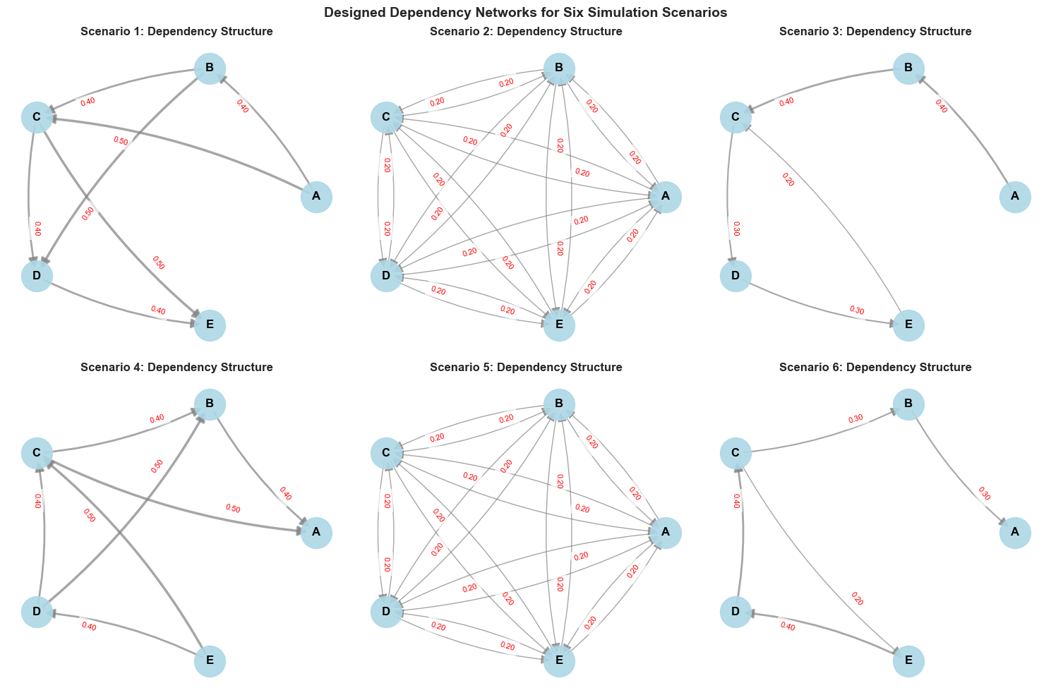
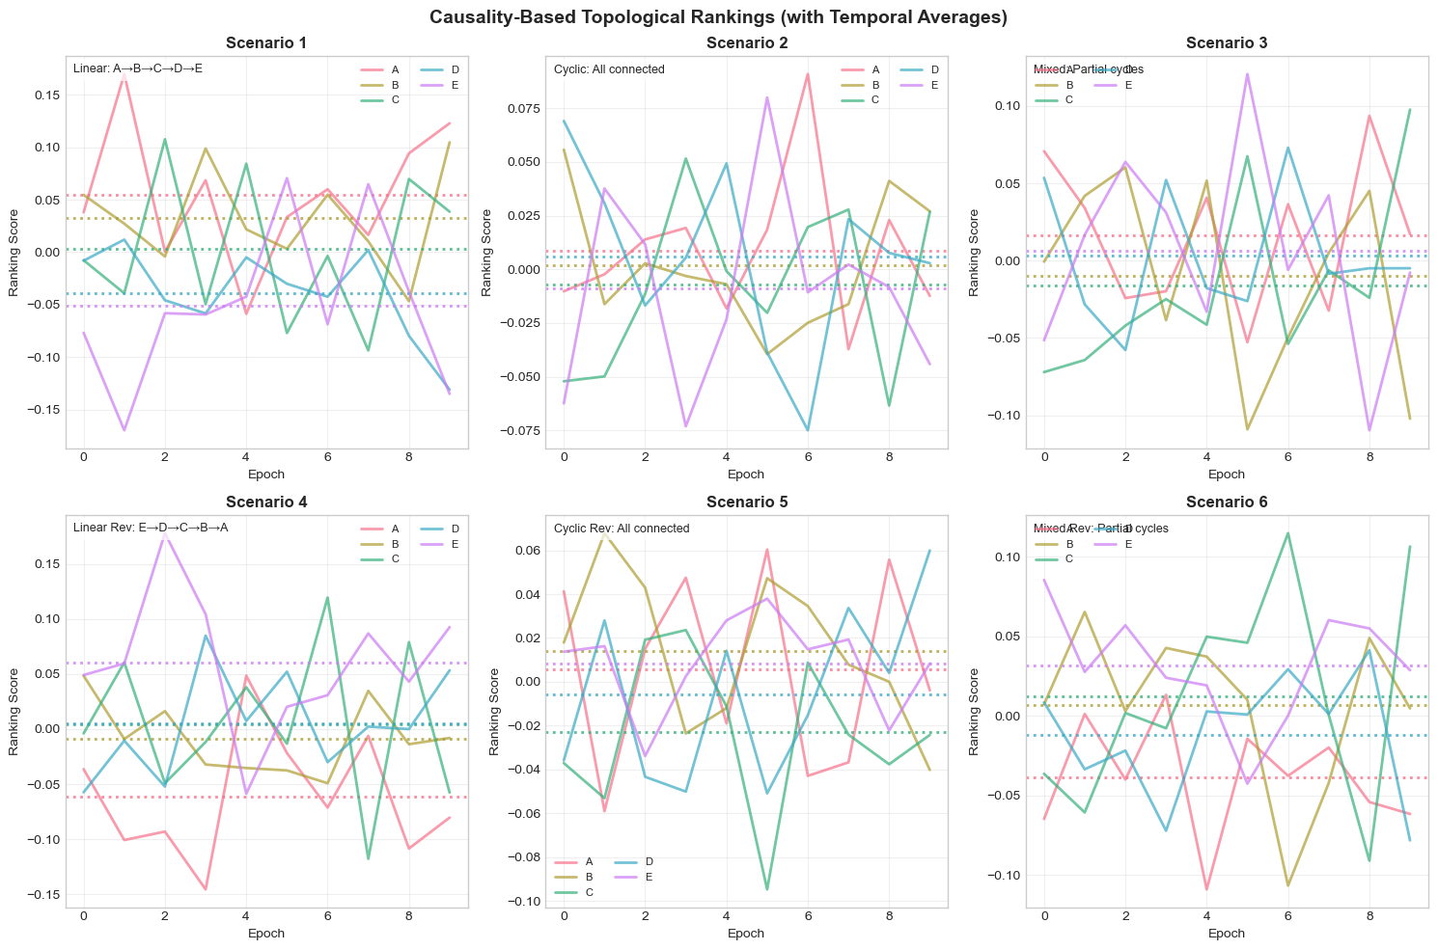
Results of Experiment
CBTR ranking matches ground truth: e.g. stable top-down order in linear cases, inconsistent/fluctuating scores in cyclic cases.
Confirms the method robustly uncovers the intended hierarchical patterns in different dependency structures.

Slide 13
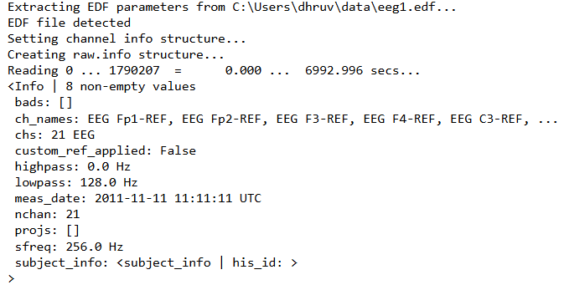
EEG Data Analysis and Pipeline
Dataset: 19-channel neonatal EEG from 79 infants (NICU). Seizures are expertly annotated; we restrict analysis to epochs that were consistently labeled seizure or non-seizure.
Preprocessing: We worked on first differences of the EEG (Δxₜ = xₜ − xₜ₋₁) computed on short epochs to reduce strong autocorrelation and suppress spurious lagged dependencies.
Analysis pipeline: Per subject, estimate directed (effective) connectivity with PCMCI, compute net directional flows and apply Hodge decomposition / CBTR to produce per-channel ranking scores for each epoch; compare ranking scores from 20 seizure vs 20 non-seizure epochs using t-tests.
EEG Dataset Info

Slide 14
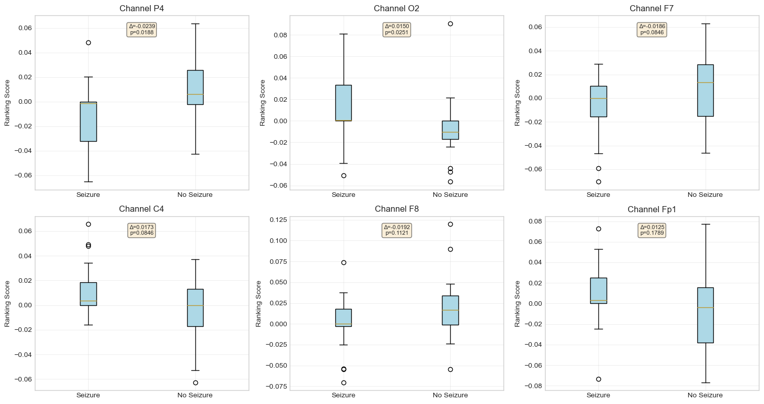
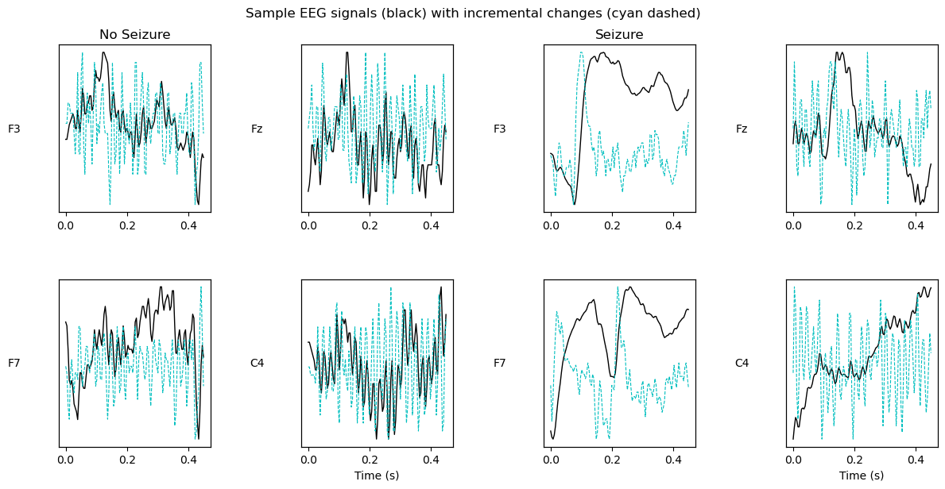
Results on EEG Data
First Differencing Reduces Strong Autocorrelation and Spurious Causal Relationships
Channels with most significant shifts in Ranking Scores
Several channels show statistically significant shifts in their ranking during seizures (very small p-values). Example subjects display clear channel-level changes where particular electrodes gain or lose hierarchical influence during seizures.
With first-differencing preprocessing, CBTR pinpoints the channels most affected and therefore helps localize seizure-related reorganization in neonatal EEG.

Slide 15
Conclusions
Seizures reconfigure the brain’s directional hierarchy — some regions become stronger net drivers while others are suppressed.
Novel framework: CBTR uniquely integrates causal inference with Hodge decomposition to study effective (directed) brain connectivity. It provides node rankings based on mutual causal influence, offering a new view of complex brain dynamics.
Validation: Simulations show CBTR reliably identifies known hierarchical structures in multivariate time series.
EEG insights: Application to neonatal seizures revealed which brain regions change hierarchy during seizures, offering deeper understanding of seizure impacts.
Clinical potential: By highlighting directed drivers of seizures, this method pinpoints the channels most affected and therefore helps localize seizure-related reorganization in neonatal EEG.

Slide 16
Future Work
Incorporate Homology Based Methods for Topological Ranking.
Apply CBTR more broadly to epilepsy data to refine seizure localization and dynamics.

Slide 17
Thank You!

